Slide 1
Team Genesis
Team Members:
Yoga Dharshini G - dharshini.govind@aspiresystems.biz
Harini R - harini.rajkumar@aspiresystems.biz
Brindha M - brindha.muruga@aspiresystems.biz
Gugan RB - gugan.balamurugan@aspiresystems.biz
Yalapala sekhar - yalapala.jayaram@aspiresystems.biz
Nagaraj K - nagaraj.kanagaraj@aspiresystems.biz
Chitrarasu V - chitrarasu.venugopal@aspiresystems.biz
Ramakrishna P - ramakrishna.ravi@aspiresystems.biz
Kishore Kumar AN - kishore.natrajan@aspiresystems.biz
Dinesh Kumaar B - dinesh.boopathy@aspiresystems.biz

Slide 2
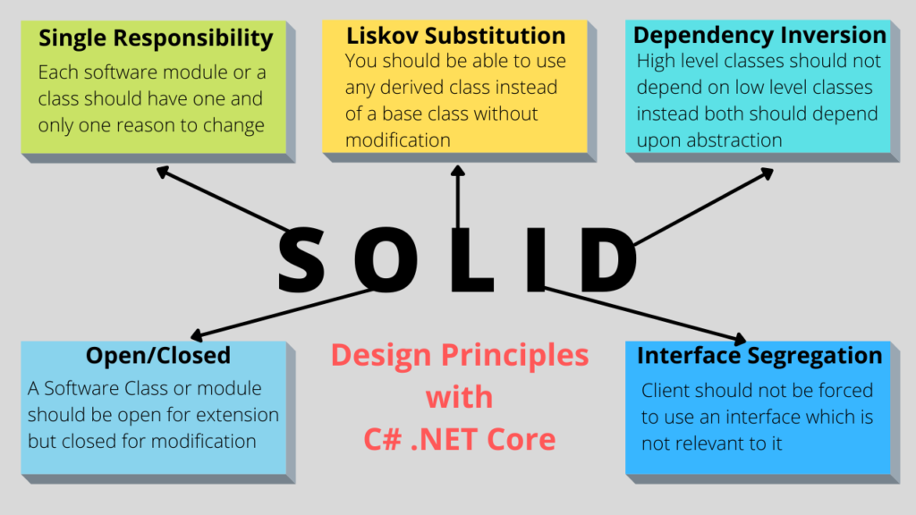
SOLID Design Principle

Slide 3
Single Responsibility
public class OrderService { public string CreateOrder(string OrderDetails) { string OrderId = ""; return OrderId; } } public class PaymentService { public bool MakePayment(string PaymentDetails) { return true; } } public class InvoiceService { public bool GenerateInvoice(string InvoiceDetails) { return true; } } public class EmailService { public bool EmailInvoice(string EmailDetails) { return true; } }
public class OrderService { public string CreateOrder(string OrderDetails) { string OrderId = ""; return OrderId; } public bool MakePayment(string OrderId) { return true; } public bool GenerateInvoice(string OrderId) { return true; } public bool EmailInvoice(string OrderId) { return true; } }
Notes:
This slide is only for the trainer… You can display the poll from GTM and after the poll is taken, share the result, connect the poll result with the topic. Once done, you can hide the poll so that the PPT is visible.
I have created the poll in the GTM webinar.

Slide 4
Open-Closed Principle
public class IReportGeneration
{
/// Method to generate report
/// <param name="em"></param>
public virtual void GenerateReport(Employee em)
{
// From base
}
}
/// Class to generate Crystal report
public class CrystalReportGeneraion : IReportGeneration
{
public override void GenerateReport(Employee em)
{
// Generate crystal report.
}
}
/// Class to generate PDF report
public class PDFReportGeneraion : IReportGeneration
{
public override void GenerateReport(Employee em)
{
// Generate PDF report.
}
}
public class ReportGeneration
{
/// Report type
public string ReportType { get; set; }
/// Method to generate report
/// </summary>
/// <param name="em"></param>
public void GenerateReport(Employee em)
{
if (ReportType == "CRS")
{
// Report generation with employee data in Crystal Report.
}
if (ReportType == "PDF")
{
// Report generation with employee data in PDF.
}
}
}

Slide 5
Liskov Substitution Principle
interface IDiscount
{
double getDiscount(double TotalSales);
}
interface IDatabase
{
void Add();
}
class Enquiry : IDiscount
{
public double getDiscount(double TotalSales)
{
return TotalSales - 5;
}
}
class Customer : IDiscount, IDatabase
{ private MyException obj = new MyException();
public virtual void Add()
{
try
{
// Database code goes here
}
catch (Exception ex)
{
obj.Handle(ex.Message.ToString());
}
}
public virtual double getDiscount(double TotalSales)
{
return TotalSales;
}
}
class Enquiry : Customer
{
public override double getDiscount(double TotalSales)
{
return base.getDiscount(TotalSales) - 5;
}
public override void Add()
{
throw new Exception("Not allowed");
}
}
List<Customer> Customers = new List<Customer>();
Customers.Add(new SilverCustomer());
Customers.Add(new goldCustomer());
Customers.Add(new Enquiry());
foreach (Customer o in Customers)
{
o.Add();
}
}

Slide 6

Interface Segregation
interface IDiscount
{
double getDiscount(double TotalSales);
}
interface IDatabase
{
void Add();
}
class Enquiry : IDiscount
{
public double getDiscount(double TotalSales)
{
return TotalSales - 5;
}
}
class Customer : IDiscount, IDatabase
{ private MyException obj = new MyException();
public void Add()
{
try
{
// Database code goes here
}
catch (Exception ex)
{
obj.Handle(ex.Message.ToString());
}
}
public double getDiscount(double TotalSales)
{
return TotalSales;
}
}
interface IDiscount
{
double getDiscount(double TotalSales);
void Add();
}
class Enquiry : IDiscount
{
public double getDiscount(double TotalSales){
return TotalSales - 5;
}
public void Add() {
throw new Exception("Not allowed");
}
}
class Customer : IDiscount
{ private MyException obj = new MyException();
public void Add(){
try
{
// Database code goes here
}
catch (Exception ex)
{
obj.Handle(ex.Message.ToString());
}
}
public double getDiscount(double TotalSales){
return TotalSales;
}
}
Notes:
This slide is only for the trainer… You can display the poll from GTM and after the poll is taken, share the result, connect the poll result with the topic. Once done, you can hide the poll so that the PPT is visible.
I have created the poll in the GTM webinar.

Slide 7
Dependency Inversion Principle
public interface IOperation
{
void Initiate();
void Send();
}
public class LowLevelModule: IOperation
{
public void Initiate()
{
//do initiation before sending
}
public void Send()
{
//perform sending operation
}
}
public class HighLevelModule
{
private readonly IOperation _operation;
public HighLevelModule(IOperation operation)
{
_operation = operation;
}
public void Call()
{
_operation.Initiate();
_operation.Send();
}
}
public class HighLevelModule
{
private readonly LowLevelModule _lowLowelModule;
public HighLevelModule()
{
_lowLevelModule = new LowLevelModule();
}
public void Call()
{
_lowLevelModule.Initiate();
_lowLevelModule.Send();
}
}
public class LowLevelModule
{
public void Initiate()
{
//do initiation before sending
}
public void Send()
{
//perform sending operation
}
}

Slide 8


